Slide 1
Classification Problem
Semiconductor manufacturing problem
By: Abdullah Othman

Slide 2
Problem Analysis
Objective: Predict whether a semiconductor unit passes or fails quality checks.
Data source: Sensor readings collected at multiple points in the manufacturing process.
Importance: Early detection of potential failures reduces waste, improves yield, and saves costs.
Type: Binary classification (Pass = 1, Fail = 0).
Challenges:
High-dimensional data from multiple sensors.
Possible noise or drift in sensor readings.
Class imbalance because failures are rare.

Slide 3
Dataset Analysis
Size: 1567 rows X 592 columns
Features: Sensor readings.
Target variable: Pass/Fail indicator.
Data types:
1 column of int64 data, that indicates the target (-1,1), changed into (fail = 0 , pass = 1).
1 column of time series (object) data, that represent the start time of the production of a wafer.
590 column of float64 data, that represent the readings of the sensors.
Each sensor’s reading have different range of values, some are in rage (0-1), and others are in range (2000-3500).
Class balance: 14 pass :1 fail.
Data quality:
The data has multiple features that has a lot of NaN values.

Slide 4
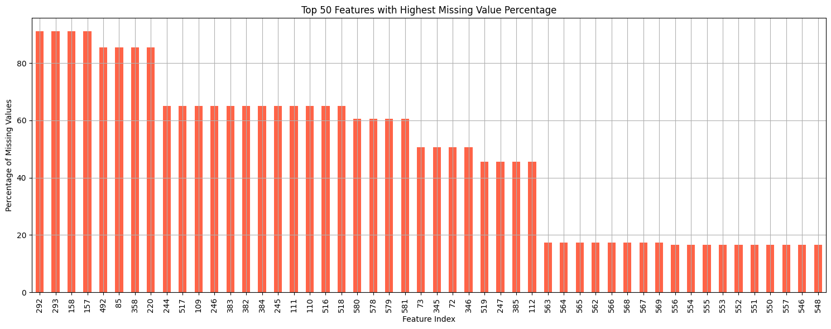
Dataset Analysis – Missing Values
Missing Values Percentage | 0-10% (0-157) | 10-20% (157-314) | 20-30% (314-471) | 30-40% (471-628) | 40-50% (628-785) | 50-60% (785-942) | 60-70% (942-1099) | 70-80% (1099-1256) | 80-90% (1256-1413) | 90-100% (1413-1570)
Number of Columns | 540 | 20 | 0 | 0 | 4 | 4 | 16 | 0 | 4 | 4

Slide 5
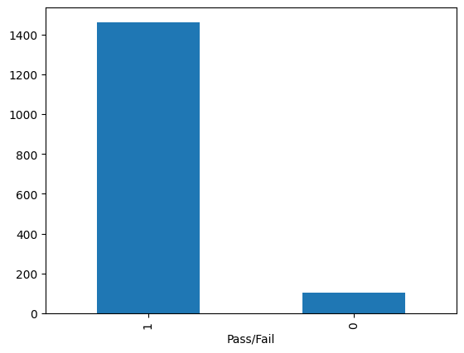
Dataset Analysis - Class Distribution
This chart shows the imbalance of the data, where the ratio between the classes is almost 14 passes for each fail.
This imbalance will affect the choice of metrics and sampling strategy.

Slide 6
Data Preprocessing
Handling Missing Data: Applied median window filling, where each missing value was replaced with the median of a sliding window of 11 points within the same column.
Correlation Filtering: Removed one feature from each pair with a correlation coefficient greater than 0.9.
Scaling: Standardized the data using StandardScaler to ensure features have zero mean and unit variance.
Feature Selection: Used Random Forest and Extra Trees to calculate feature importance, retaining only the top features that collectively accounted for 90% of the total importance.

Slide 7
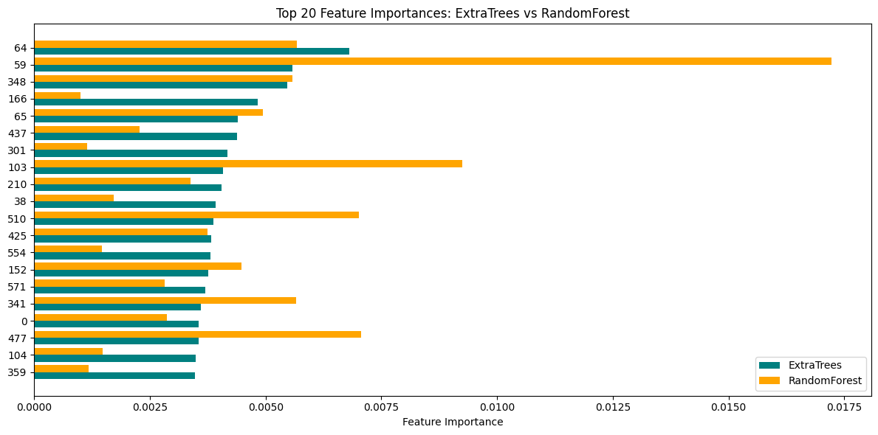
Feature Importance
This chart shows the top 20 most influential sensor readings for predicting pass/fail outcomes. Both ExtraTrees (teal) and RandomForest (orange) rank sensors differently in importance, but there is overlap in several high-impact features (e.g., sensors 59, 64, 348).
Sensor 59 is a standout for RandomForest, having the highest importance overall.

Slide 8
Models
Trained multiple models: Logistic Regression, XGBoost, KNN, GaussianNB, Decision Tree, Random Forest, and SVC.
Model evaluation: Assessed performance using multiple evaluation metrics to identify the best model.
Cross-validation: Applied to improve training reliability and reduce overfitting, because we have imbalanced data (14 pass: 1 fail).

Slide 9
Machine Specifications
The models have been trained on a machine with:
Intel core I7-6700QH Processor
Number of physical cores: 4
Number of logical CPUs: 8
16 GB of RAM

Slide 10
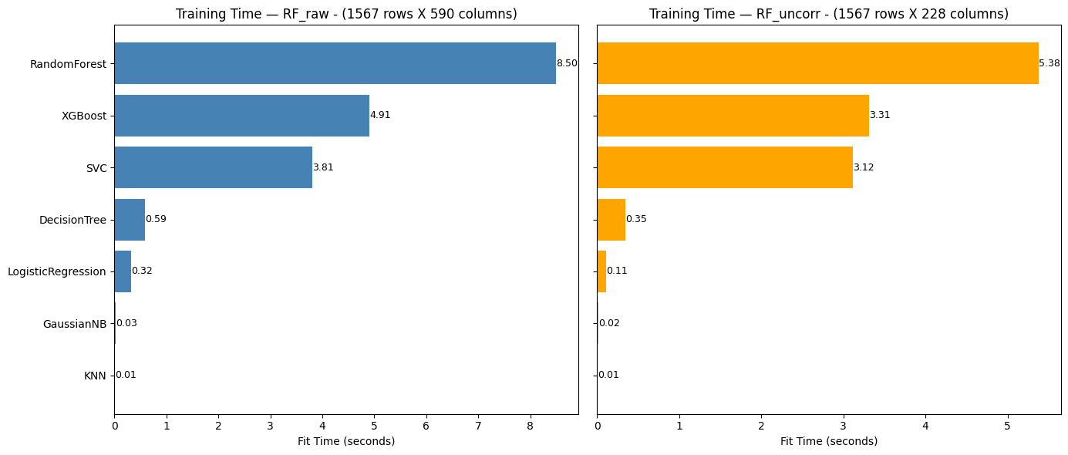
Average Training Time
RandomForest has the slowest training time, even with reduced features.
Training speed depends on multiple factors (e.g., splitting methods, tree depth), not just feature count in RandomForest.
Fastest models: KNN and GaussianNB.
Slowest models: RandomForest and XGBoost.
XGBoost is faster than RandomForest due to its optimized C++ implementation.

Slide 11
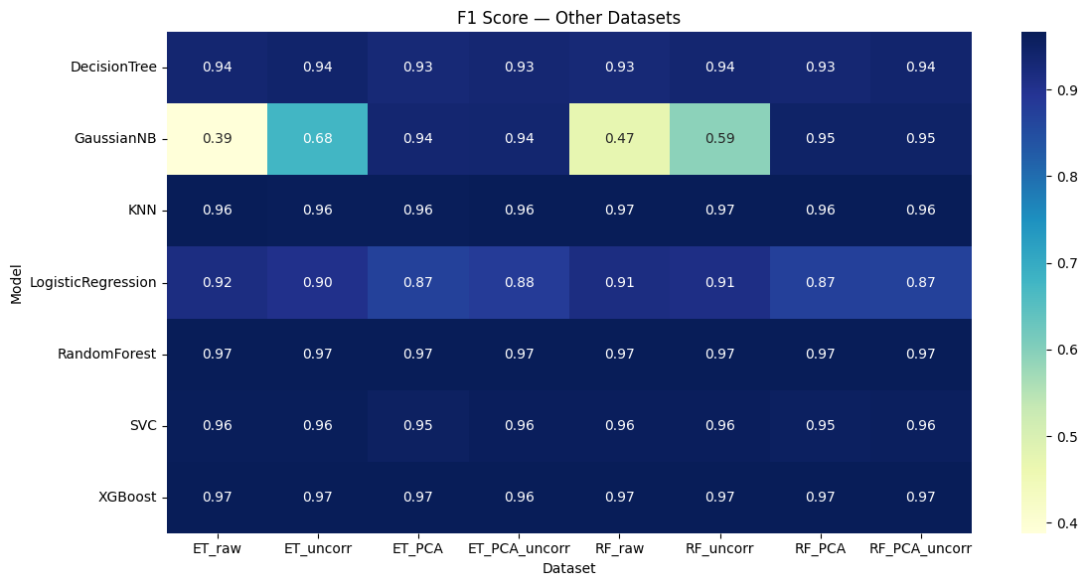
F1 –Score Comparison
The lowest F-1 score is for GaussianNB, and that’s because it’s sensitive to high dimensionality (a lot of features).
The best 2 models are RandomForest and XGBoost.
Most of models have 0.96 and 0.97 F1-score, which is a good indicator for them.

Slide 12
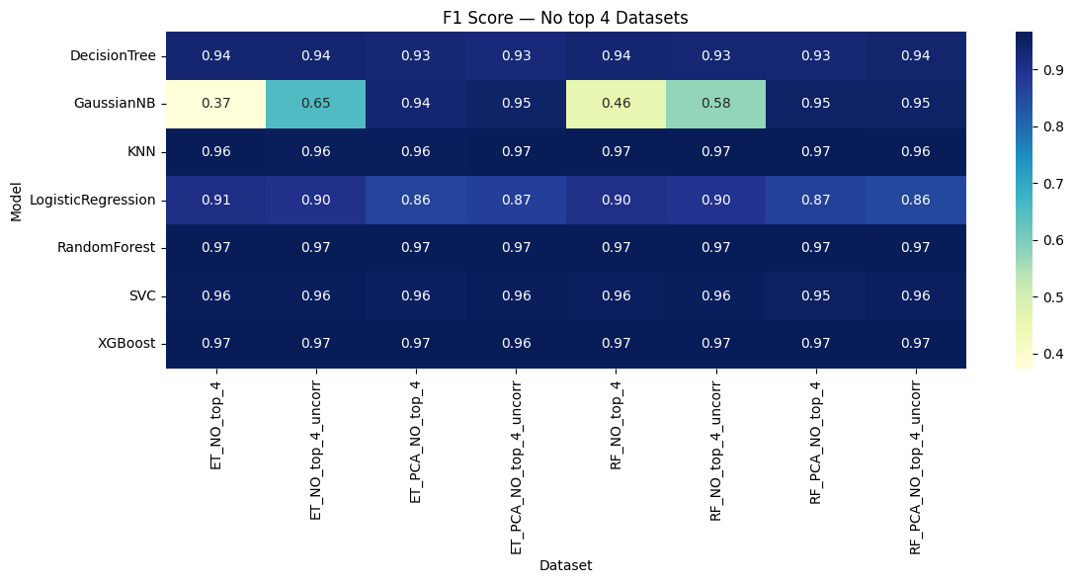
F1 –Score Comparison - Remove the Top 4 Important Features
Dropping the top 4 important features affected some models slightly, except for the GaussianNB, which was affected model.

Slide 13
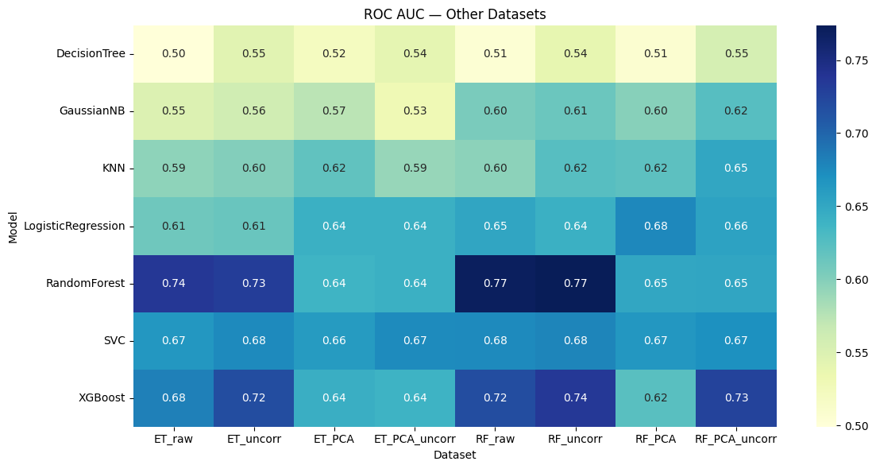
AUC Comparison
This plot shows the AUC value for each model vs dataset.
The PCA affected negatively on RandomForest and XGBoost but it affected positively on models like Logistic Regression.
Based on the values the XGBoost and RandomForest give the highest values.

Slide 14
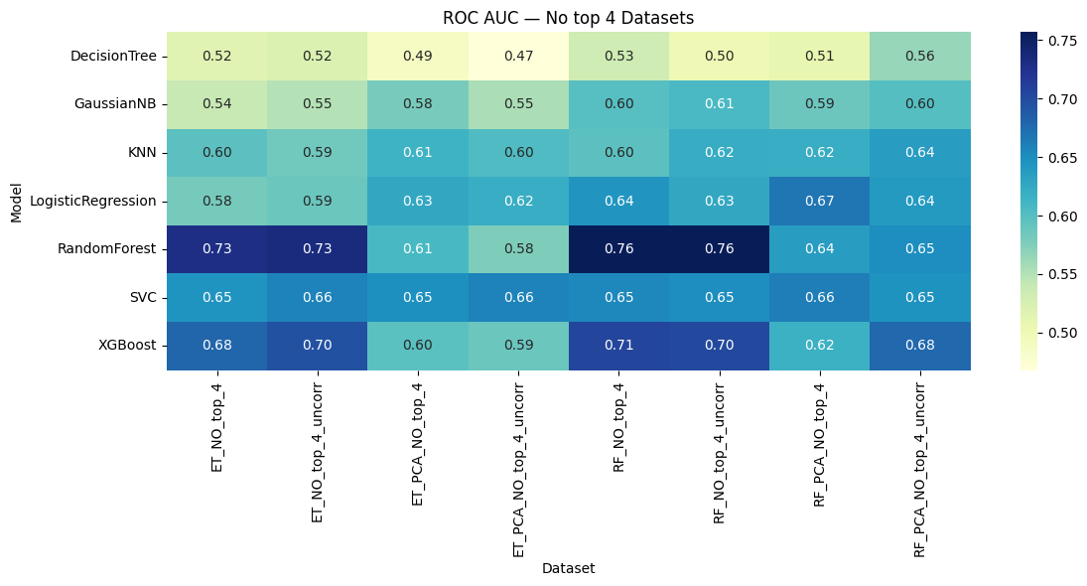
AUC Comparison - Remove the Top 4 Important Features
The RandomForest feature importance selecting yields greater results than the ExtraTree feature importance selecting for the highest AUC values.
The drop in values after removing the top 4 features from RF was greater than the drop from ET, which means the affect of RF feature importance was higher.

Slide 15
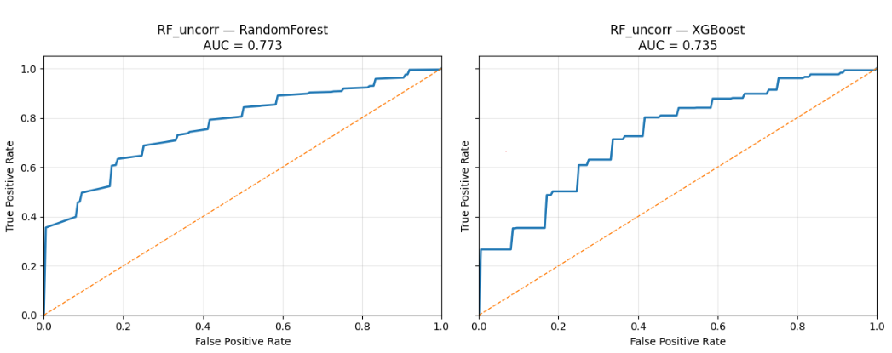
ROC AUC Comparison
Random Forest (AUC = 0.773): Shows better separation between classes, higher true positive rates at most false positive rates.
XGBoost (AUC = 0.735): Slightly lower performance, indicating less class separation compared to Random Forest.
Random Forest outperforms XGBoost in this dataset by +0.038 AUC.
Both models perform significantly better than random guessing (AUC = 0.5).

Slide 16
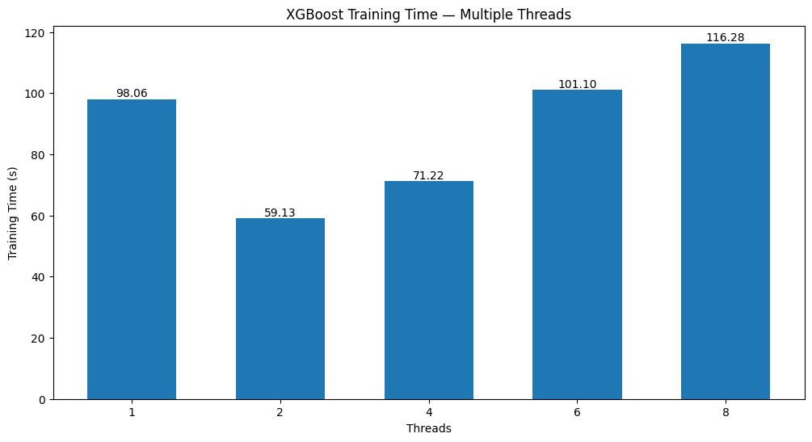
XGBoost on Multiple Threads - Time
Best Performance at 2 Threads: Fastest training time observed (59.13s).
Lower Returns Beyond 2 Threads: Running more threads extends the training period.
This plot shows the train time for XGBoost on multiple threads, on a dataset of
(157000 row X 590 column)

Slide 17
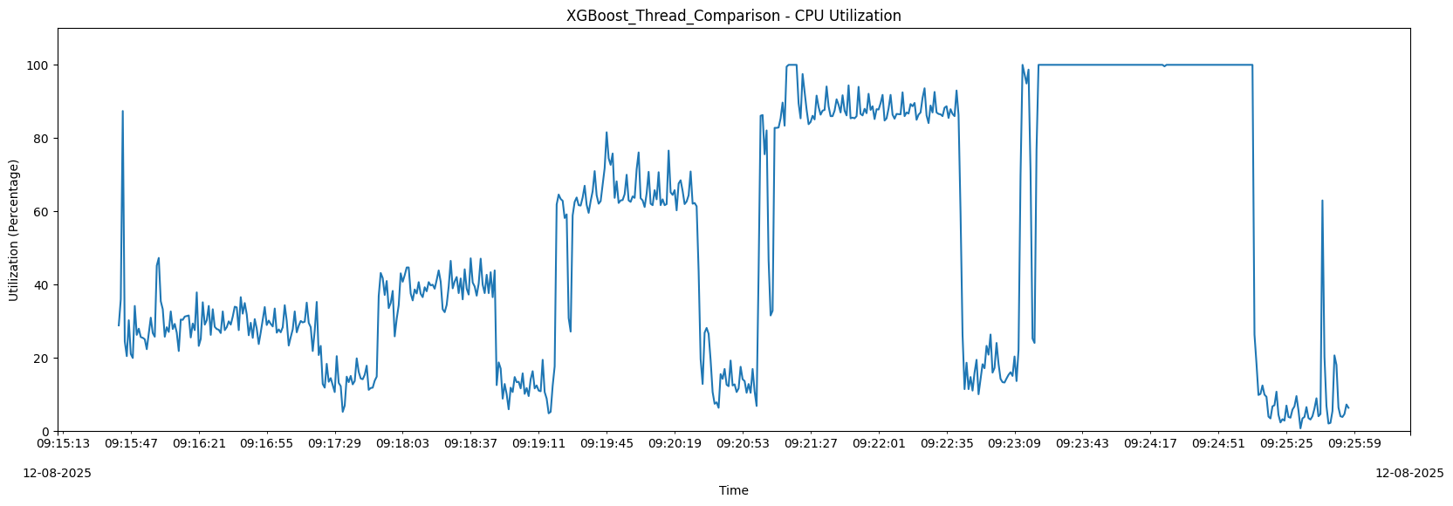
XGBoost on Multiple Threads - CPU
CPU usage varies from 20% to 100%.
1 Thread: Low and stable usage (~25–40%), minimal spikes.
2 Threads: Moderate and steady utilization (~35–45%).
4 Threads: Sustained higher load (~60–80%), more fluctuations.
6 Threads: Frequent 90–100% utilization.
8 Threads: Flat 100% utilization for a long period.
More threads doesn’t mean faster training. Optimal performance was achieved with 2 threads, balancing CPU load and execution efficiency.
1 Thread
2 Threads
4 Threads
6 Threads
8 Threads
This plot shows the CPU utilization for XGBoost on multiple threads, on a dataset of
(157000 row X 590 column)

Slide 18
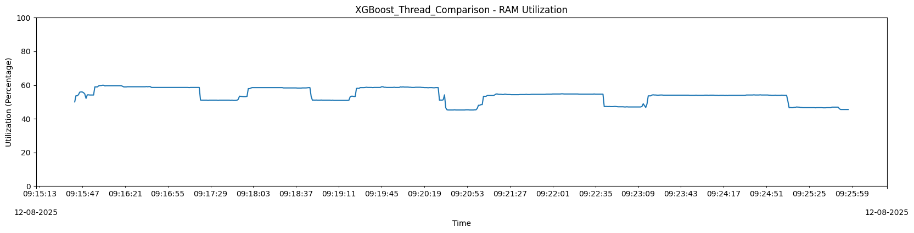
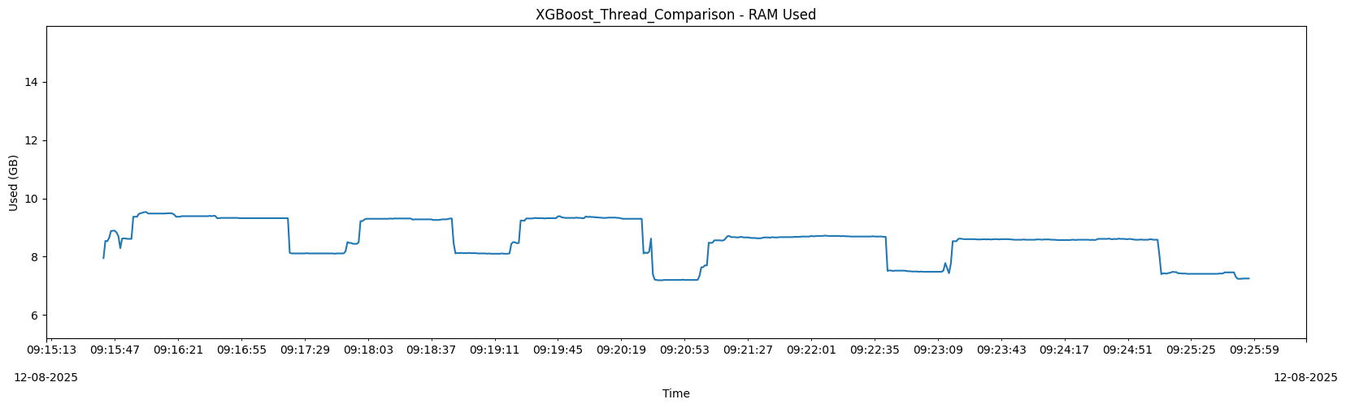
XGBoost on Multiple Threads - RAM
RAM utilization percentage remains mostly between 50–60% for all thread counts, showing XGBoost’s memory demand is not highly sensitive to threading.
Consistently between 8–9.5 GB during training.
Unlike CPU usage, increasing threads did not significantly increase RAM usage.
These plots show the RAM utilization and usage for XGBoost on multiple threads, on a dataset of (157000 row X 590 column)

Slide 19
But the XGBoost can perform well on multiple threads, even with higher number of threads.

Slide 20
So, is it a Hardware issue or a Software one?

Slide 21
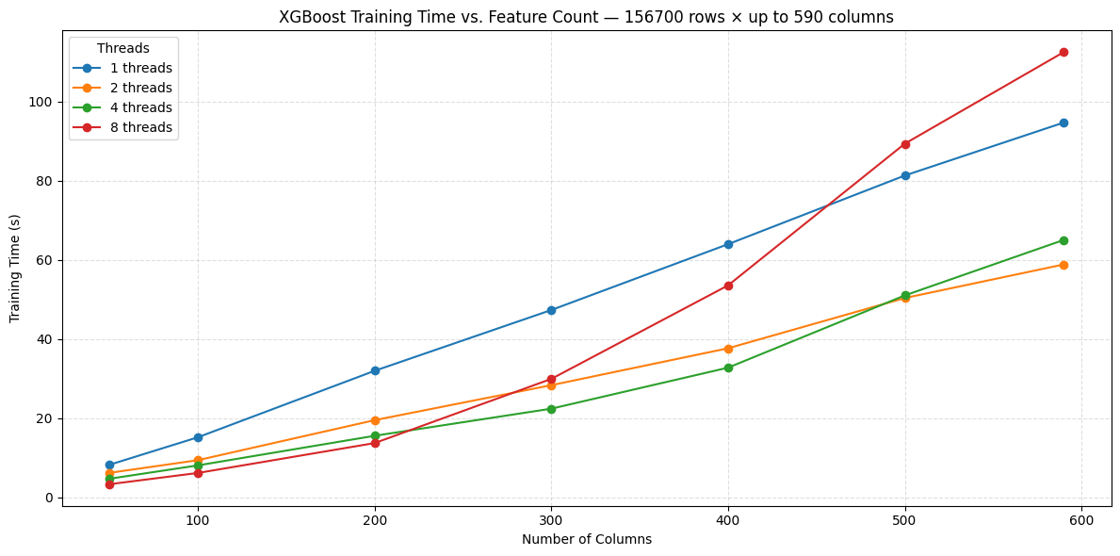
XGBoost on Multiple Threads - Columns vs. Threads
More features = longer training.
XGBoost’s histogram building can cause thread imbalance.
Imbalance grows with large, unevenly sparse feature spaces, leading to poor scaling with high thread counts.
After ~300 columns, full CPU load on 8 threads leads to slower training.
The plot shows the correlation between the number of columns and train time based on the number of threads.

Slide 22
Conclusion
Best Accuracy: For maximum predictive quality, use RandomForest without PCA. Delivers top performance, even if training takes longer.
Best Accuracy with Moderate Time: For the balancing between performance and the predictive quality of the model, using XGBoost with multiple threads is the best choice.
Dimensionality: High dimensionality will affect the train time of the XGBoost on higher number of threads.
Time Only Matters: For the fastest model, choose KNN, but it doesn’t give a good model, so the performance will be bad.
PCA Usage: Apply PCA on complex models like RandomForest and XGBoost, affects the model negatively and make the performance worse.
Imbalanced Data Strategy: Evaluate model performance using AUC and F1 score, with an emphasis on accurately detecting the minority “fail” class.

